Slide 1
Machine Learning
Lecture 2

Slide 2
Features
Features are the individual measurable properties of the signal being observed.
Individual independent variables that act like a input in your system
Feature represents the column or attribute of the data used for analysis such as the Number of rooms, size of the house, et
The set of features used for learning/recognition is called feature vector.

Slide 3
Features
The number of input variables or features for a dataset is referred to as its dimensionality.
Dimensionality reduction refers to techniques that reduce the number of input variables in a dataset. ... Large numbers of input features can cause poor performance for machine learning algorithms

Slide 4
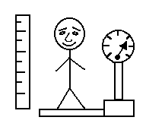
Features
height
weight
Class 1
Class 1
Class 2
Class 2

Slide 5
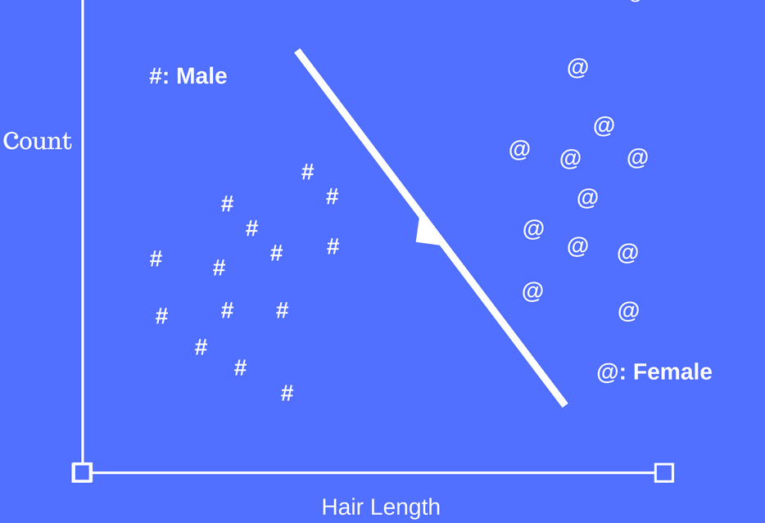
Feature space

Slide 6
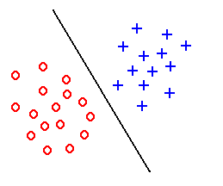
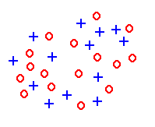
Feature Extraction
Feature extraction aims to create discriminative features good for learning
Good Features
Objects from the same class have similar feature values.
Objects from different classes have different values.
“Good” features
“Bad” features

Slide 7
Features
Use fewer features if possible
Use features that differentiate classes well
Character recognition example
Good features: aspect ratio, presence of loops
Bad features: number of black pixels, number of connected components

Slide 8
Recognition
Supervised learning
Classification
Regression
Unsupervised learning
Reinforcement learning

Slide 9
CLASSIFICATION

Slide 10

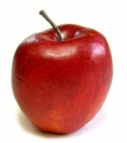
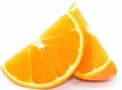
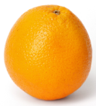
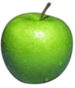
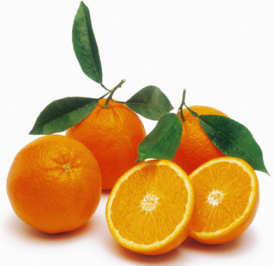


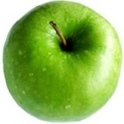
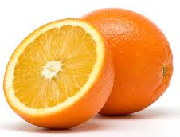
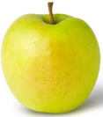
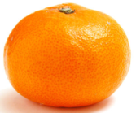
Supervised learning - Classification
Objective
Make a 2 year old kid recognize what is an apple and what is an orange
Strategy: Show some examples of each category
Apples
Oranges

Slide 11
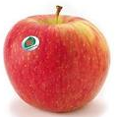


Classification
You had some training example or ‘training data’
The examples were ‘labeled’
You used those examples to make the kid ‘learn’ the difference between an apple and an orange
What is this???
Its an apple!!!

Slide 12
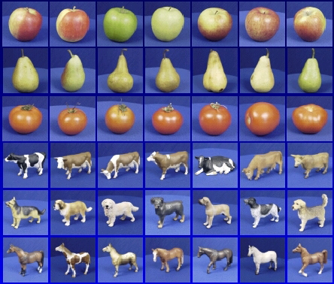

Classification
Apple
Pear
Tomato
Cow
Dog
Horse
Given: training images and their categories
What are the categories of these test images?

Slide 13
Classifier: identify the class of given pattern
Distance between Feature Vectors
Instead of finding template exactly matching input template look at how close feature vectors are
Nearest neighbor classification algorithm:
Find template closest to the input pattern.
Classify pattern to the same class as closest template.
Class 1
Class 2

Slide 14
classifier
K-Nearest Neighbor Classifier
Use k nearest neighbors instead of 1 to classify pattern.
Class 1
Class 2

Slide 15
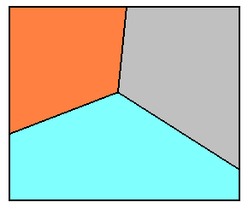
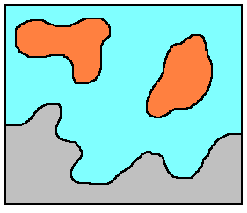
classifier
A classifier partitions feature space X into class-labeled regions such that:
and
The classification consists of determining to which region a feature vector x belongs to.
Borders between regions are called decision boundaries

Slide 16
Classification
Cancer Diagnosis – Generally more than one variables
Malignant
Benign
Age
Tumor Size
Why supervised – The algorithm is given a number of patients with the RIGHT ANSWER and we want the algorithm to learn to predict for new patients

Slide 17
Classification
Cancer Diagnosis – Generally more than one variables
Predict for this patient
Malignant
Benign
Age
Tumor Size
We want the algorithm to learn the separation line. Once a new patient arrives with a given age and tumor size – Predict as Malignant or Benign

Slide 18
Supervised Learning - Example
Cancer diagnosis – Many more features
Use this training set to learn how to classify patients where diagnosis is not known:
Input Data
Classification

Slide 19
Contents
Supervised learning
Classification
Regression
Unsupervised learning
Reinforcement learning

Slide 20
REGRESSION

Slide 21
Regression
CLASSIFICATION
The variable we are trying to predict is DISCRETE
REGRESSION
The variable we are trying to predict is CONTINUOUS

Slide 22
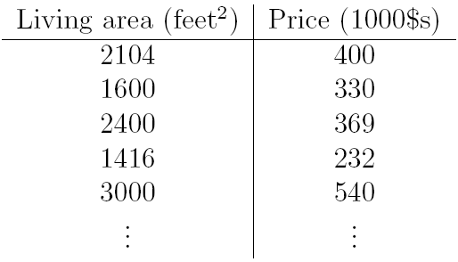
Regression
Dataset giving the living areas and prices of 50 houses

Slide 23
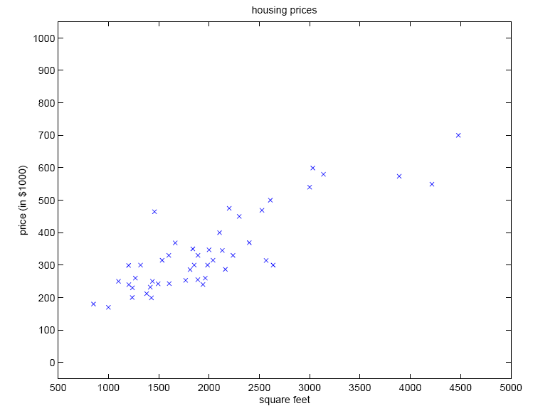
Regression
We can plot this data
Given data like this, how can we learn to predict the prices of other houses as a function of the size of their living areas?

Slide 24
Regression
The “input” variables – x^{(i)} (living area in this example)
The “output” or target variable that we are trying to predict – y^{(i)} (price)
A pair (x^{(i)}, y^{(i)}) is called a training example
A list of m training examples {(x^{(i)}, y^{(i)}); i =
1, . . . ,m}—is called a training set
X denote the space of input values, and Y the space of output values

Slide 25
Regression

Slide 26
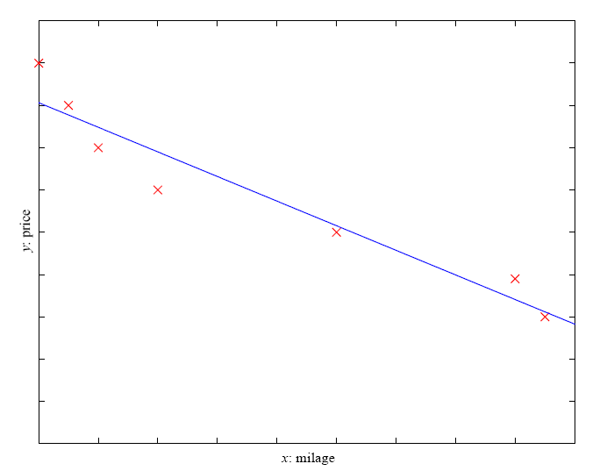
Regression
Example: Price of a used car
x : car attributes
y : price

Slide 27
Contents
Supervised learning
Classification
Regression
Unsupervised learning
Reinforcement learning

Slide 28
CLUSTERING

Slide 29

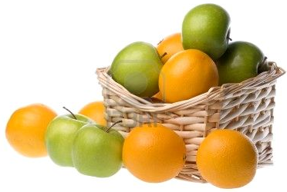
UNSUPERVISED LEARNING
CLUSTERING
There are two types of fruit in the basket, separate them into two ‘groups’

Slide 30
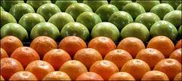
UNSUPERVISED LEARNING
CLUSTERING
The data was not ‘labeled’ you did not tell which are apples which are oranges
May be the kid used the idea that things in the same group should be similar to one another as compared to things in the other group
Groups - Clusters
Separate groups or clusters

Slide 31
Clustering
Age
Tumor Size
We have the data for patients but NOT the RIGHT ANSWERS. The objective is to find interesting structures in data (in this case two clusters)

Slide 32
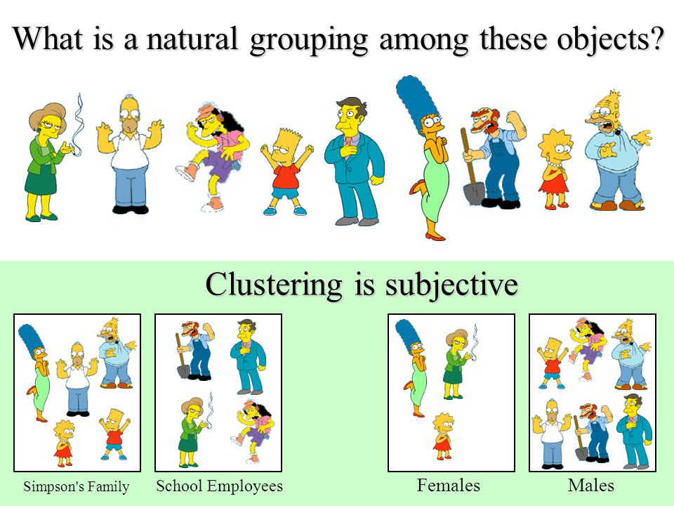

Slide 34




Unsupervised Learning – Cocktail Party Effect
Speakers recorded speaking simultaneously

Slide 35


Unsupervised Learning – Cocktail Party Effect
Source Separation
Data can be explained by two different speakers speaking – ICA algorithm
Source: http://cnl.salk.edu/~tewon/Blind/blind_audio.html

Slide 36
Independent Component Analysis
Independent Component Analysis (ICA) is a machine learning technique to separate independent sources from a mixed signal.
Unlike principal component analysis which focuses on maximizing the variance of the data points, the independent component analysis focuses on independence, i.e. independent components.

Slide 37
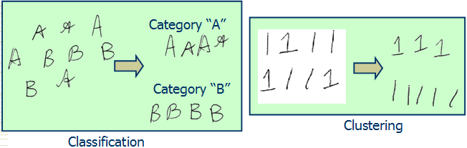
Classification vs Clustering
Challenges
Intra-class variability (between two groups)
Inter-class similarity (within or inside one group)

Slide 38






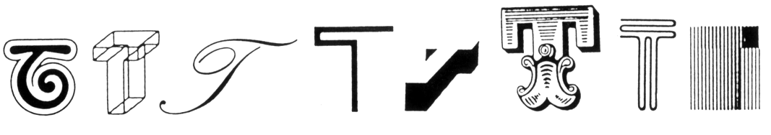
Intra class variability
The letter “T” in different typefaces
Same face under different expression, pose, illumination

Slide 39

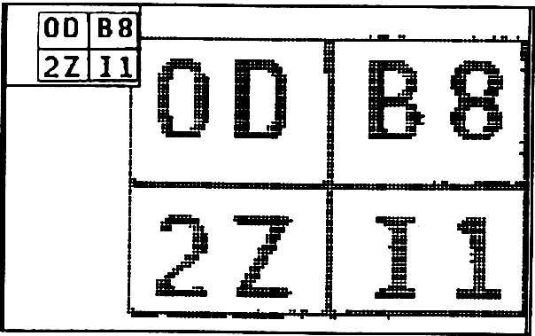
Inter class similarity
Characters that look similar
Identical twins

